Slide 1
Exploratory Data Analysis of NYC: Insights from Shooting, COVID-19, and Job Placement Datasets
Welcome to an in-depth exploration of New York City through the lens of data analysis. This project delves into three crucial aspects of urban life: public safety, public health, and employment. By examining NYC's shooting incidents, COVID-19 statistics, and job placement data, we aim to uncover meaningful insights that paint a comprehensive picture of life in the Big Apple.
Our journey will take us through the intricate process of data exploration, cleaning, and analysis using Python and SQL. We'll create compelling visualizations, tackle real-world data challenges, and propose future directions for this analytical venture. Join us as we unravel the complex tapestry of America's largest city, one dataset at a time.
by Paul Rohit
Shivani Polaboyna
Samadarshini
Scalable Databases

Slide 2
Data Exploration and Cleaning: Preparing the Groundwork
The first crucial step in our analysis involves exploring and cleaning the three datasets: NYC Shooting Incidents, COVID-19 statistics, and Job Placements. Using Python's pandas library, we meticulously examined each dataset for missing values, outliers, and inconsistencies. This process is vital for ensuring the integrity and reliability of our subsequent analyses.
For the NYC Shooting Dataset, we addressed missing values in the perpetrator demographics, potentially using imputation techniques or creating a separate category for unknown data. The COVID-19 dataset required careful handling of cumulative versus daily counts, while the Job Placements dataset needed standardization of date formats and salary ranges.
1
Data Loading and Initial Inspection
Import datasets into pandas DataFrames and use methods like .info(), .describe(), and .head() to get an overview of the data structure and content.
2
Handling Missing Values
Identify missing data using .isnull().sum() and decide on appropriate strategies (deletion, imputation, or flagging) based on the nature and extent of missingness.
3
Outlier Detection and Treatment
Use statistical methods and visualization techniques to identify outliers. Decide whether to remove, transform, or keep outliers based on domain knowledge and analysis goals.
4
Data Type Conversion and Standardization
Ensure consistent data types across columns, convert date strings to datetime objects, and standardize categorical variables for uniformity in analysis.
Scalable Databases

Slide 3
Python for Data Analysis: Unveiling Patterns and Trends
With our datasets cleaned and preprocessed, we leveraged Python's powerful data analysis libraries to uncover meaningful patterns and trends. Pandas served as our primary tool for data manipulation and analysis, while NumPy facilitated advanced numerical computations.
For the NYC Shooting Dataset, we analyzed temporal patterns of incidents, identifying hotspots and peak times. The COVID-19 data allowed us to track the progression of the pandemic across different boroughs, while the Job Placements dataset revealed insights into hiring trends and salary distributions.
Temporal Analysis
Geospatial Patterns
Statistical Inference
Using pandas' datetime functionality, we aggregated shooting incidents and COVID-19 cases by day, week, and month to identify trends and seasonality. Time series decomposition helped separate long-term trends from cyclical patterns.
We mapped shooting incidents and job locations using libraries like GeoPandas, revealing geographical hotspots and areas of economic activity. This analysis helped identify potential correlations between crime rates and employment opportunities.
Employing scipy.stats, we conducted hypothesis tests to examine relationships between variables, such as the correlation between COVID-19 cases and hospitalization rates or the impact of visa status on job placement success.
Scalable Databases

Slide 4
OBJECTIVE OF THE NYC SHOOTING DATASET
The objective of this dataset is to provide detailed information on each shooting incident that occurred within New York City for the specified period.
This data is intended to:
1. Enhance Public Awareness and Transparency: Make information on violent incidents accessible to the public, contributing to an open understanding of the frequency, locations, and contexts in which shootings occur across NYC.
2. Support Law Enforcement and Crime Analysis: Enable law enforcement agencies, policymakers, and analysts to identify patterns, trends, and
hotspots related to shootings. This insight can be crucial for resource allocation, crime prevention, and community policing strategies.
3. Enable Community Engagement and Safety Initiatives: By understanding the demographics of victims and perpetrators and the contexts of each incident, community organizations and city programs can design targeted safety interventions and preventative measures.
4. Provide a Resource for Researchers and Journalists: Facilitate independent research and reporting by providing granular data about NYC shootings, supporting data-driven insights and accountability in crime prevention efforts.

Slide 5
OBJECTIVE OF NYC COVID DATASET
The objective of this dataset is to monitor and analyze trends in COVID-19 cases, hospitalizations, and deaths over time.
By tracking daily figures and seven-day averages, this dataset allows for the assessment of:
Trends in COVID-19 Transmission: Observing confirmed, and probable case counts helps determine how the virus
spreads over time and assesses periods of increase or decrease in cases.
2. Hospitalization and Mortality Rates: Tracking hospitalizations and deaths provides insight into the severity of cases,
the impact on healthcare resources, and the overall mortality rate associated with COVID-19.
3.Impact by Location: The inclusion of the Bronx-specific case count (BX_CASE_COUNT) allows for localized analysis,
helping to understand how different regions may be differently affected by COVID-19.
4. Rolling Averages for Stability: Seven-day averages smooth out daily fluctuations, offering a clearer picture of
longer-term trends and more stable indicators of changes in COVID-19 activity.
Overall, this dataset supports health departments, policymakers, and researchers in making informed decisions related
to public health responses, resource allocation, and measures to mitigate the spread and impact of COVID-19.

Slide 6
OBJECTIVE OF PLACAMENT DATASET
The objective of this dataset is to provide a detailed record of job placements, focusing on the key aspects of each placement,
including:
Hiring Trends and Analysis: Track and analyze trends in hiring across different roles, locations, and visa statuses, which
can support talent acquisition strategies and workforce planning.
2. Salary Benchmarking: Facilitate comparison of salaries for various roles across locations and job types to understand
industry standards and adjust compensation packages accordingly.
3. Relocation and Time Zone Insights: Provide information on relocation needs and time zone compatibility, helping
identify patterns in geographic mobility and remote work feasibility.
4. Candidate Demographics and Visa Status: Document visa status and consultant locations to understand employment
patterns for international candidates and those with various work authorizations, such as H1B or Green Card.
5. Tracking Hiring Outcomes and Effectiveness: Record interview results and hiring decisions, allowing insights into
interview-to-hire success rates and potential factors influencing hiring outcomes.
This dataset is valuable for HR professionals, recruiters, and analysts to make informed decisions in recruitment,
compensation, and workforce allocation based on hiring patterns, geographical data, and role-specific insights.

Slide 7
FEATURES OF NYC SHOOTING DATASET
This dataset appears to be a log of criminal incidents. Here’s an explanation of each feature:
Incident_key: A unique identifier for each incident in the dataset.
occur_date: The date the incident occurred, formatted in ISO format (`YYYY-MM-DDTHH:MM:SS`), where the "T" separates date and time.
occur_time: The specific time of day the incident occurred, typically formatted in `HH:MM:SS` (24-hour format).
boro: The borough in which the incident took place (e.g., Queens, Brooklyn, Bronx, Manhattan). New York City boroughs are used here.
loc_of_occur_desc: A brief description of the location type of the incident, indicating if it happened "INSIDE" or "OUTSIDE.“
precinct: The police precinct number responsible for the area where the incident occurred. Precincts are subdivisions within boroughs.
jurisdiction_code: A numeric code representing the jurisdiction responsible for handling the incident. This may refer to specific police or other legal entities.
loc_classfctn_desc: Describes the general classification of the location, such as "STREET," "COMMERCIAL," "DWELLING," or "HOUSING," giving context to where the incident happened.
statistical_murder_flag: Indicates whether the incident was categorized as a murder. A `TRUE` value means it was a murder, while `FALSE` means it was not.
perp_age_group: The age group of the perpetrator(s), if known. Some values are `null`, which indicates missing information.
perp_sex: The gender of the perpetrator(s), if known. `null` indicates missing information.
perp_race: The race of the perpetrator(s), if known. `null` indicates missing information.
vic_age_group: The age group of the victim(s), if available, categorized in ranges like `<18`, `18-24`, `25-44`, `45-64`, and `65+`.
vic_sex: The gender of the victim(s), if available, typically "M" for male and "F" for female.
vic_race: The race of the victim(s), if available. Descriptions include ethnic classifications like "BLACK," "WHITE," "HISPANIC," and combinations like "BLACK HISPANIC."

Slide 8
FEATURES OF PLACEMENT DATASET
This dataset contains information about job placements for consultants. Here's a detailed explanation of each feature:
Job Title: The title or role for the job position (e.g., "SAP," "Big Data," "DevOps Engineer").
Job Location: The city and state where the job is based (e.g., "Austin, TX" or "Dallas, TX").
Job Time Zone: The time zone of the job location, such as CST (Central Standard Time), EST (Eastern Standard Time), or PST (Pacific Standard Time).
Consultant Name: The name of the consultant who has been considered or hired for the job role.
Visa: The visa status or work authorization of the consultant, such as "H1B," "US Citizen," "Green Card" (GC), or "GC EAD.“
Consultant Location: The city and state where the consultant resides.
Consultant Time Zone: The time zone of the consultant’s location, such as EST, CST, or PST.
Salary ($1000): The annual salary offered for the job, represented in thousands of dollars (e.g., "$110K" represents $110,000).
Relocation: Indicates if the job requires relocation. A "Yes" means relocation is required, and "No" means it is not.
Submission Date: The date on which the consultant's profile was submitted for the job, formatted as `DD/MM/YYYY`.
Joining Date: The planned or actual joining date for the consultant in the new role.
Interview Status: Indicates the outcome of the interview process, such as "Cleared," showing that the consultant successfully cleared the interview.
Hired: A flag indicating whether the consultant was hired for the role. "Y" means they were hired, and "N" means they were not.

Slide 9
FEATURES OF NYC COVID DATASET
This dataset captures COVID-19-related data across various dates, focusing on case counts, hospitalizations, and deaths. Here’s an explanation of
each feature:
1. date_of_interest: The specific date for which the data is recorded, formatted as `MM/DD/YYYY`.
2. CASE_COUNT: The total confirmed COVID-19 cases reported on the specified date.
3. PROBABLE_CASE_COUNT: The number of probable COVID-19 cases reported on the date. These cases might be based on symptoms or rapid
tests rather than confirmed PCR tests.
4. HOSPITALIZED_COUNT: The count of COVID-19-related hospitalizations reported on the specified date.
5. DEATH_COUNT: The count of COVID-19-related deaths reported on that date.
6. CASE_COUNT_7DAY_AVG: The seven-day average of confirmed case counts leading up to and including the specified date, used to smooth out
daily fluctuations.
7. ALL_CASE_COUNT_7DAY_AVG: The seven-day average of the combined confirmed and probable cases up to and including the date.
8. HOSP_COUNT_7DAY_AVG: The seven-day average of hospitalizations up to and including the date.
9. DEATH_COUNT_7DAY_AVG: The seven-day average of deaths due to COVID-19 up to and including the date.
10. BX_CASE_COUNT: The confirmed case count specifically for the Bronx (indicated by "BX") on the specified date.

Slide 10

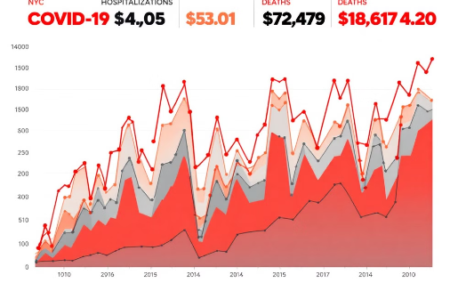
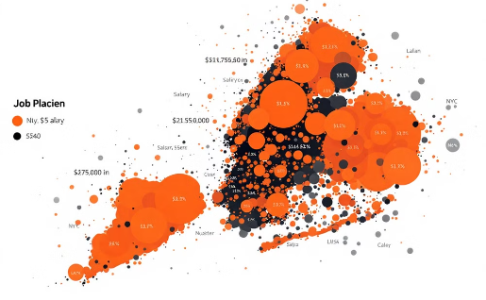
Data Visualization: Bringing NYC Data to Life
To effectively communicate our findings, we created a series of compelling data visualizations using libraries such as Matplotlib, Seaborn, and Plotly. These visualizations not only make our analysis more accessible but also reveal patterns that might be obscured in raw data.
Our first visualization is a heatmap of shooting incidents across NYC boroughs, highlighting high-risk areas and temporal patterns. For the COVID-19 data, we developed an interactive line chart showing the progression of cases, hospitalizations, and deaths over time. Lastly, we created a bubble chart representing job placements, where bubble size corresponds to salary and color indicates industry sector.
NYC Shooting Incidents Heatmap
COVID-19 Progression in NYC
NYC Job Placements Bubble Chart
This heatmap visualizes the concentration of shooting incidents across NYC boroughs, using color intensity to indicate frequency. It reveals hotspots and helps identify areas that may require increased law enforcement presence or community intervention programs.
This interactive line chart tracks the progression of COVID-19 in NYC, displaying daily new cases, hospitalizations, and deaths. Users can zoom in on specific time periods, revealing the impact of public health measures and vaccination campaigns on the pandemic's trajectory.
This bubble chart represents job placements across different industries in NYC. Bubble size corresponds to salary ranges, while colors indicate industry sectors. This visualization helps identify high-paying industries and the distribution of job opportunities across sectors.
Scalable Databases

Slide 11
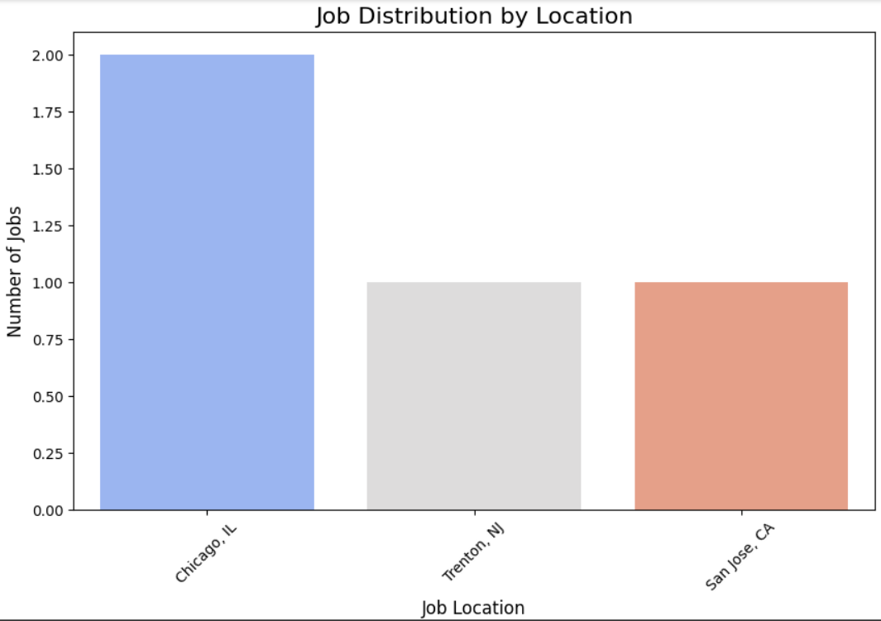
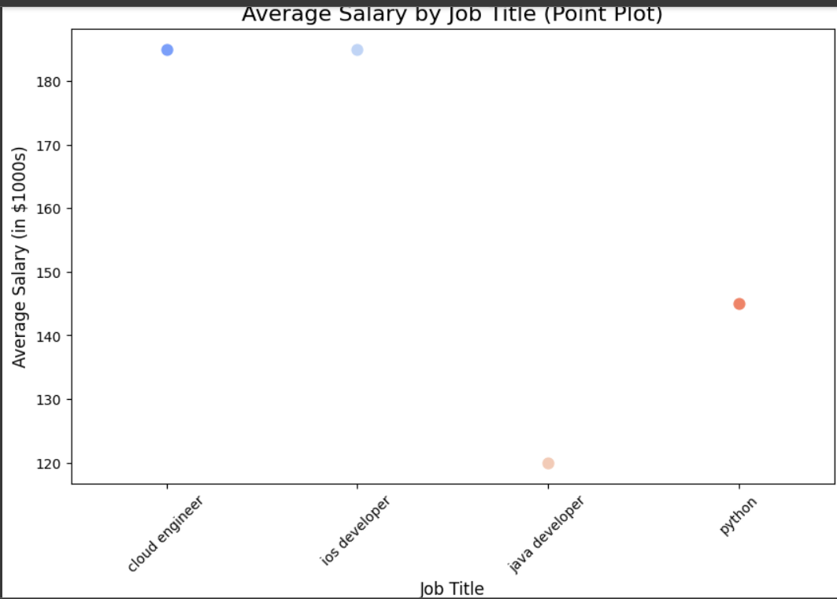
Visualisation of Placement
This bar chart shows job distribution across locations, with Chicago, IL having the highest number of jobs at 2, while Trenton, NJ, and San Jose, CA each have 1 job.
This point plot displays the average salary for various job titles, showing that cloud engineers and iOS developers earn the highest salaries, around $180,000, while Java developers earn the lowest, close to $120,000.

Slide 12
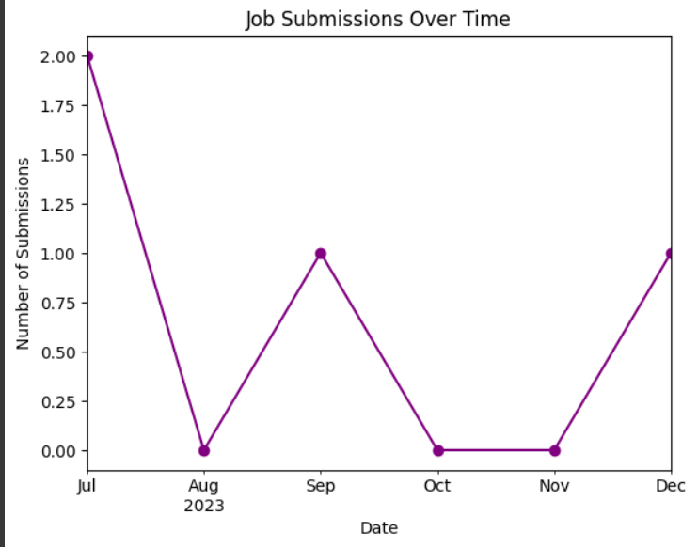
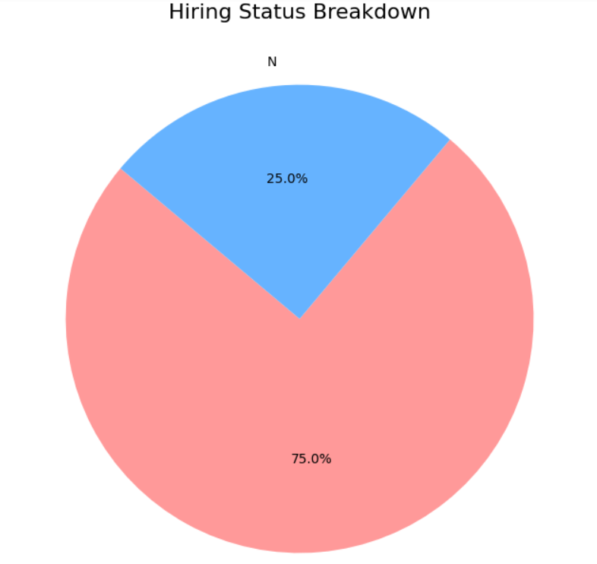
This line chart shows job submissions over time, with fluctuations from July to December 2023. Submissions peaked in July, dropped to zero in August, and showed occasional activity through the rest of the year.
This pie chart shows the hiring status breakdown, with 75% in one category (likely not hired) and 25% in another (likely hired). The two segments are represented with different colors for easy differentiation.

Slide 13
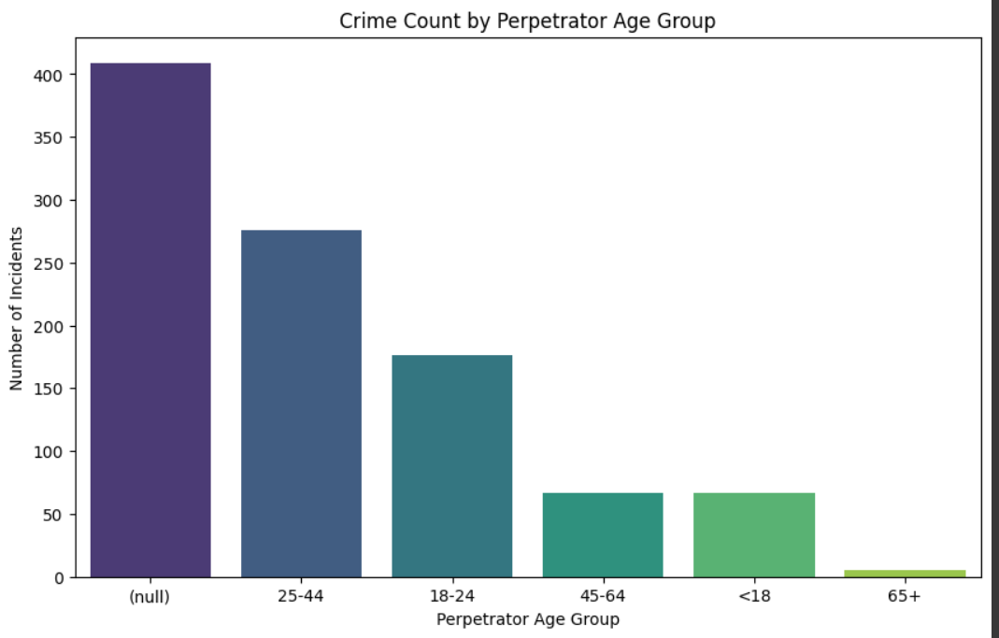
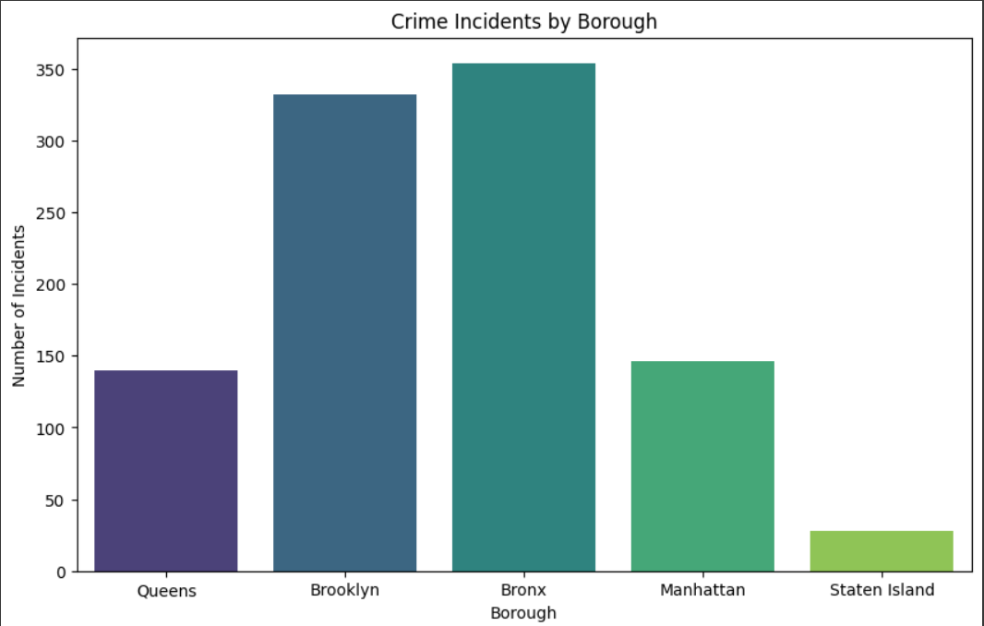
Visualization of shooting
This bar chart shows crime counts by perpetrator age groups. The highest number of incidents falls in the "null" category, indicating missing age data. Among recorded ages, most crimes are committed by individuals aged 25-44, followed by 18-24. Crimes by younger (<18) and older (65+) individuals are relatively rare.
This bar chart shows crime incidents by borough. The Bronx and Brooklyn have the highest crime counts, while Queens and Manhattan have lower numbers. Staten Island has the fewest incidents, indicating a lower crime rate compared to other boroughs.
Visualization of shooting

Slide 14
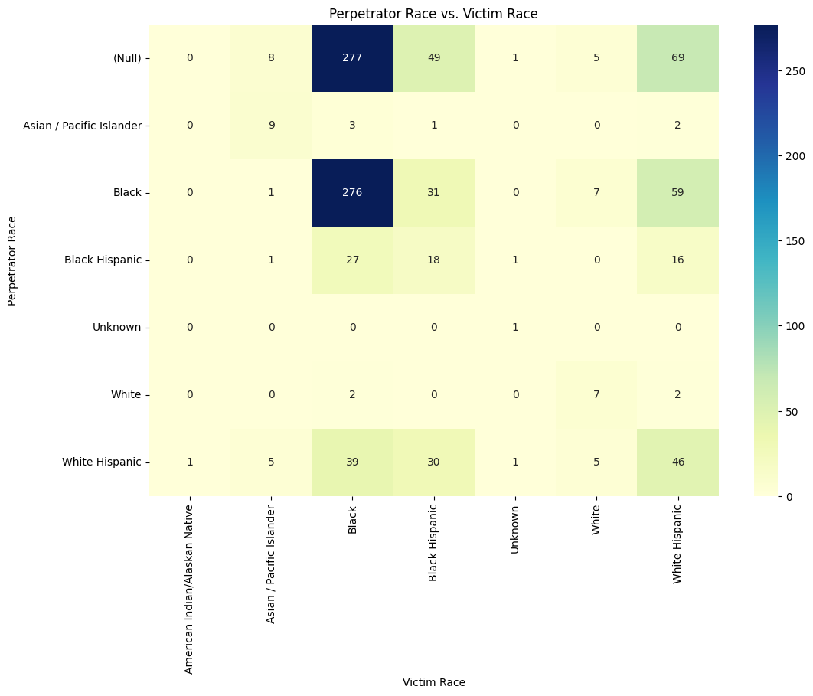
Heatmap of shooting
This heatmap shows the relationship between perpetrator and victim race. The highest counts are for "(Null)" and "Black" perpetrators targeting "Black" victims, with 277 and 276 incidents, respectively. "White Hispanic" perpetrators also frequently target "White Hispanic" victims. Lower incident counts are spread across other racial combinations. The color intensity represents the frequency, highlighting prominent trends.

Slide 15
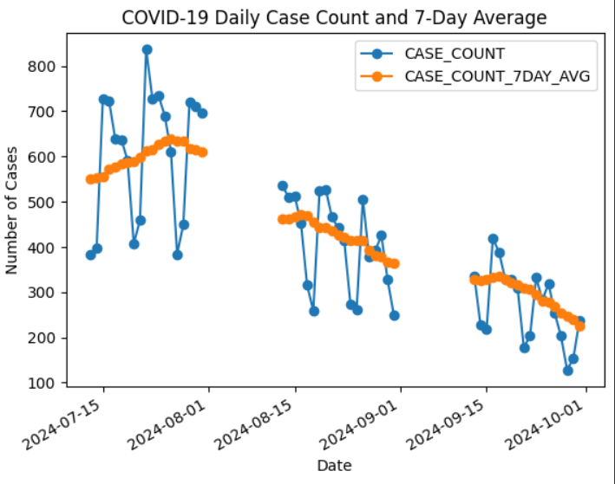
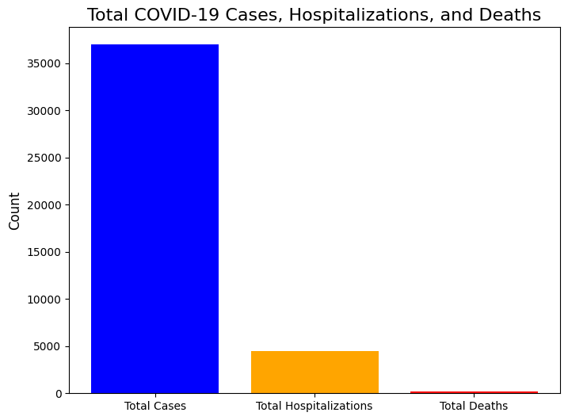
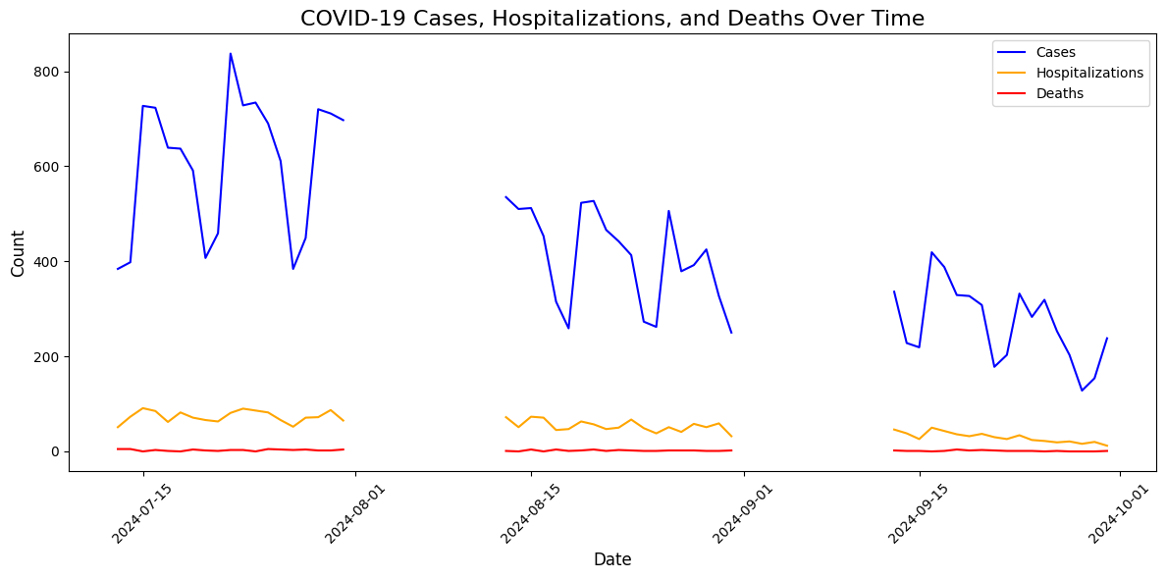
Visualization of Covid
This bar chart compares total COVID-19 cases, hospitalizations, and deaths. Total cases are the highest, with significantly fewer hospitalizations and a minimal number of deaths.
This graph shows daily COVID-19 case counts (in blue) alongside a 7-day moving average (in orange) from July to October 2024. The 7-day average smooths out fluctuations, highlighting trends in case numbers over time.
This line graph shows COVID-19 cases, hospitalizations, and deaths over time. Cases (blue) fluctuate widely, showing peaks and declines, while hospitalizations (orange) and deaths (red) remain relatively low and stable throughout the period. This suggests that while case numbers vary, severe outcomes remain consistently lower.

Slide 16
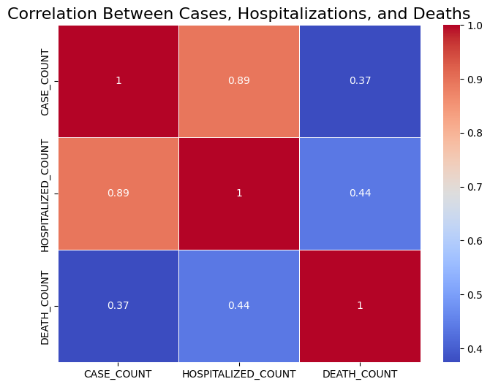
HEATMAP OF COVID
This heatmap shows the correlation between case counts, hospitalizations, and deaths. The correlation values range from -1 to 1, where:
CASE_COUNT and HOSPITALIZED_COUNT have a strong positive correlation (0.89), indicating that as cases increase, hospitalizations also tend to increase.
CASE_COUNT and DEATH_COUNT have a weaker correlation (0.37), implying a less direct relationship between cases and deaths.
HOSPITALIZED_COUNT and DEATH_COUNT have a moderate positive correlation (0.44), suggesting a stronger but still moderate relationship compared to case counts and deaths.

Slide 17
SQL Queries: Extracting Insights from Complex Data
To extract deeper insights from our datasets, we employed SQL queries for data retrieval, transformation, and analysis. These queries allowed us to perform complex joins, aggregations, and filtering operations across our three datasets, uncovering relationships that might not be immediately apparent.
We wrote a series of SQL queries to answer specific questions about NYC's urban landscape. For example, we joined the shooting incidents data with COVID-19 statistics to explore potential correlations between crime rates and pandemic intensity. Another query combined job placement data with borough-level COVID-19 information to investigate the pandemic's impact on employment trends.
Query Purpose
SQL Complexity
Datasets Used
Crime rate vs. COVID-19 cases
High
Shooting, COVID-19
Job placements by borough
Medium
Job Placements
Temporal trends in shootings
Medium
Shooting
COVID-19 impact on employment
High
COVID-19, Job Placements
Demographic analysis of victims
Low
Shooting
Scalable Databases

Slide 18
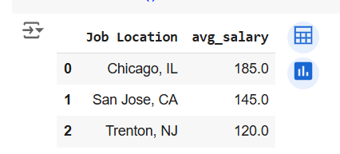
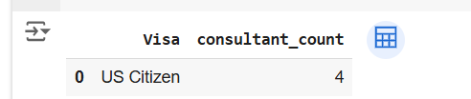
SQL QUERIES PLACEMENT DATASET
The query calculates and lists the average salary for each job location, sorted from highest to lowest average salary
SELECT
"Job Location",
AVG(CAST("Salary ($1000)" AS FLOAT)) AS avg_salary
FROM
df_jobs
GROUP BY
"Job Location"
ORDER BY
avg_salary DESC;
The query counts the number of consultants for each visa type from the `df_jobs` table and sorts the results in descending order of
consultant count.
SELECT
"Visa",
COUNT("Consultant Name") AS consultant_count
FROM
df_jobs
GROUP BY
"Visa"
ORDER BY
consultant_count DESC;
"""
result = ps.sqldf(query, locals())
result.head()

Slide 19
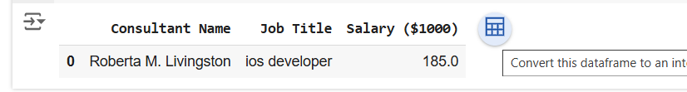
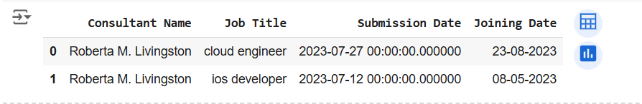
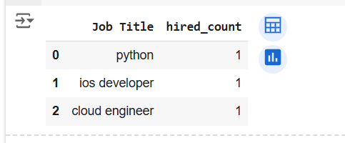
SQL QUERIES PLACEMENT
The query retrieves the consultant names, job titles, and salaries for those consultants in the `df_jobs` table who are
open to relocation.
SELECT
"Consultant Name",
"Job Title",
"Salary ($1000)"
FROM
df_jobs
WHERE
"Relocation" = 'Yes';
"""
result = ps.sqldf(query, locals())
result.head()
The query counts the number of hires for each job title where the hiring status is 'y' and lists the job titles in
descending order of hire count.
SELECT "Job Title", COUNT("Hired") AS hired_count FROM df_jobs WHERE "Hired" = 'y' GROUP BY "Job Title" ORDER BY hired_count DESC;
The query retrieves the consultant names, job titles, submission dates,
and joining dates for consultants who were hired and whose submission dates
fall between July 12, 2023, and December 14, 2023.

Slide 20
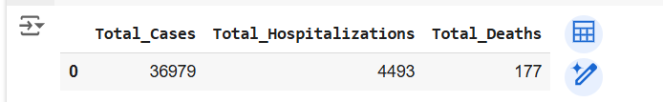
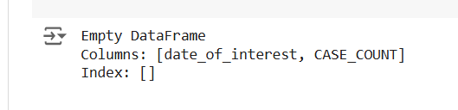
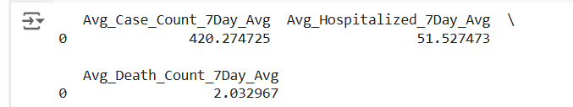
SQL NYC COVID DATASET
The query calculates the total number of COVID-19 cases, hospitalizations, and deaths from the `df_covid` table.
SELECT
SUM(CASE_COUNT) AS Total_Cases,
SUM(HOSPITALIZED_COUNT) AS Total_Hospitalizations,
SUM(DEATH_COUNT) AS Total_Deaths
FROM df_covid;
"""
result = ps.sqldf(query, locals())
result
The query retrieves dates and corresponding case counts from the `df_covid` table where the case count is greater than 1000,
and it sorts the results in ascending order by date.
SELECT
date_of_interest,
CASE_COUNT
FROM df_covid
WHERE CASE_COUNT > 1000
ORDER BY date_of_interest ASC;
"""
result = ps.sqldf(query, locals())
print(result)
The query counts the number of incidents for each hour of the day from the `df` table, grouping by the hour
(extracted from the `occur_time`), and sorts the results in ascending order of the hour.
SELECTAVG(CASE_COUNT_7DAY_AVG) AS Avg_Case_Count_7Day_Avg,AVG(HOSP_COUNT_7DAY_AVG) AS Avg_Hospitalized_7Day_Avg,
AVG(DEATH_COUNT_7DAY_AVG) AS Avg_Death_Count_7Day_AvgFROM df_covid;
result = ps.sqldf(query, locals())print(result)

Slide 21

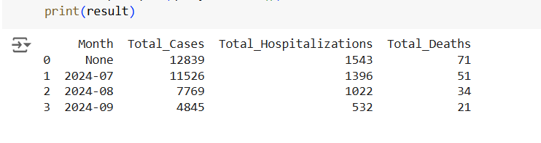
SQL QUERIES NYC COVID DATASET
This SQL query retrieves the date with the highest number of COVID cases from the `df_covid` DataFrame, ordering the results by case count
in descending order and limiting the output to the single date with the most cases.
SELECT date_of_interest, BX_CASE_COUNT FROM df_covid ORDER BY BX_CASE_COUNT DESC LIMIT 1; """
# Execute the query using pandasql result = ps.sqldf(query, locals()) print(result)
This SQL query aggregates COVID data from the `df_covid` DataFrame by month, calculating the total number of cases, hospitalizations, and deaths for
each month, and then orders the results chronologically by month.
SELECT
strftime('%Y-%m', date_of_interest) AS Month,
SUM(CASE_COUNT) AS Total_Cases,
SUM(HOSPITALIZED_COUNT) AS Total_Hospitalizations,
SUM(DEATH_COUNT) AS Total_Deaths
FROM df_covid
GROUP BY strftime('%Y-%m', date_of_interest)
ORDER BY Month ASC;
"""
# Execute the query using pandasql
result = ps.sqldf(query, locals())
print(result)

Slide 22
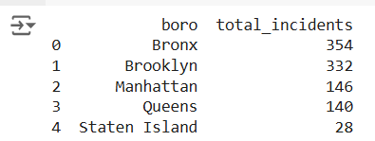

NYC SHOOTING DATASET
The query counts the total incidents in each borough (`boro`) from the `df` table, groups the results by borough, and sorts them in
descending order by the number of incidents.
SELECT
boro,
COUNT(incident_key) AS total_incidents
FROM
df
GROUP BY
boro
ORDER BY
total_incidents DESC;
"""
total_incidents_by_boro = ps.sqldf(query1)
print(total_incidents_by_boro)
The query counts incidents for each hour of the day based on `occur_time` in the `df` table, groups by hour, and displays the results in ascending order by hour.
SELECT strftime('%H', occur_time) AS occur_hour, COUNT(incident_key) AS incident_count FROM df GROUP BY occur_hour ORDER BY occur_hour; """ incidents_by_hour = ps.sqldf(query2) print(incidents_by_hour)

Slide 23
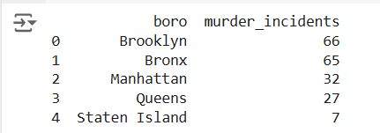
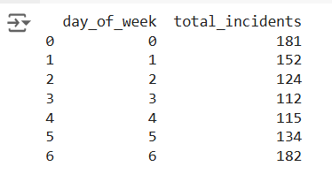
NYC SHOOTING DATASET
The query counts the number of murder incidents in each borough (`boro`) from the `df` table where `statistical_murder_flag` is true, groups the
results by borough, and sorts them in descending order by the number of murder incidents.
SELECT
boro,
COUNT(incident_key) AS murder_incidents
FROM
df
WHERE
statistical_murder_flag = TRUE
GROUP BY
boro
ORDER BY
murder_incidents DESC;
"""
murder_incidents_by_boro = ps.sqldf(query4)
print(murder_incidents_by_boro)
The query counts the total incidents for each day of the week (`day_of_week`) from the `df` table, groups by day (with 0 as Sunday through 6 as Saturday)
, and sorts the results in ascending order by day of the week.
SELECT strftime('%w', occur_date) AS day_of_week, -- 0 = Sunday, 1 = Monday, ..., 6 = Saturday COUNT(incident_key) AS total_incidents FROM df GROUP BY
day_of_week ORDER BY day_of_week; """ crime_trends_by_day = ps.sqldf(query6) print(crime_trends_by_day)

Slide 24
Challenges and Solutions: Navigating Data Complexities
Throughout our analysis, we encountered several challenges that required creative problem-solving. Two significant hurdles we faced were data integration issues and handling time-series data across different granularities.
The first challenge arose when attempting to integrate the shooting incidents data with COVID-19 statistics. The datasets had different temporal resolutions - daily for COVID-19 and individual incidents for shootings. We overcame this by aggregating shooting data to a daily level, allowing for meaningful comparisons.
1
Data Integration Challenge
2
Time-Series Complexity
3
Geospatial Data Handling
Solution: Developed a custom Python function to aggregate shooting incidents to a daily level, matching the granularity of the COVID-19 data. This involved careful datetime handling and groupby operations in pandas.
Solution: Utilized the pandas resample method to standardize all time-series data to a weekly frequency. This approach smoothed out daily fluctuations and allowed for more robust trend analysis across all datasets.
Solution: Implemented GeoPandas to handle the spatial aspects of our data, allowing us to perform spatial joins and create more accurate geographical visualizations of crime and job placement patterns.
Scalable Databases

Slide 25




Future Steps: Expanding the Analytical Horizon
As we conclude our current analysis, we've identified several promising avenues for future expansion and improvement of our project. These future steps aim to deepen our understanding of NYC's urban dynamics and enhance the practical applications of our findings.
One potential direction is the integration of machine learning models to predict crime hotspots or COVID-19 outbreaks based on historical data and current trends. Another exciting possibility is the development of an interactive web dashboard that allows users to explore our findings dynamically, potentially updating in real-time as new data becomes available.
Predictive Modeling
Interactive Dashboard
Real-Time Data Integration
Extended Data Sources
Implement machine learning algorithms to forecast crime rates, COVID-19 trends, and job market fluctuations based on historical patterns and current data.
Develop a web-based interactive dashboard using tools like Dash or Streamlit, allowing users to explore data visualizations and insights dynamically.
Integrate additional datasets such as weather patterns, economic indicators, or social media sentiment to provide a more comprehensive view of NYC's urban dynamics.
Set up automated data pipelines to incorporate real-time or near-real-time data feeds, ensuring our analysis remains current and actionable.
Scalable Databases

Slide 26




Automation and Efficiency: Streamlining the Analytical Process
To enhance the efficiency and reproducibility of our analysis, we've identified several areas where automation can be implemented. By automating routine tasks, we can focus more on interpreting results and deriving actionable insights.
One key area for automation is the data cleaning and preprocessing stage. We plan to develop a series of Python scripts that can automatically handle missing values, standardize formats, and perform initial quality checks on incoming data. Additionally, we aim to create automated report generation scripts that can produce regular updates on key metrics and visualizations.
Automated Data Cleaning
Automated Reporting
Data Pipeline Automation
Automated Alerts
Create scripts to generate regular reports with updated visualizations and key metrics, reducing manual effort in producing periodic updates.
Set up an alert system to notify analysts of significant changes or anomalies in the data, enabling prompt investigation and response.
Develop Python scripts to automatically clean and preprocess incoming data, handling missing values and standardizing formats across all datasets.
Implement automated ETL (Extract, Transform, Load) processes to seamlessly integrate new data from various sources into our analysis pipeline.
Scalable Databases

Slide 27
Conclusion: Illuminating NYC Through Data
Our journey through the NYC datasets has provided a multifaceted view of the city's dynamics, from public safety and health to employment trends. By leveraging Python, SQL, and various data visualization techniques, we've uncovered valuable insights that can inform policy decisions and improve urban planning.
This project demonstrates the power of data analysis in understanding complex urban environments. As we move forward, the integration of machine learning, real-time data feeds, and interactive visualizations will further enhance our ability to make data-driven decisions. The challenges we've overcome and the future steps we've outlined pave the way for even more comprehensive analyses of urban life in New York City and beyond.
Comprehensive Urban Analysis
Data-Driven Insights
Our project has successfully integrated diverse datasets to provide a holistic view of NYC's urban landscape, from crime patterns to pandemic impacts and job market trends.
Through rigorous analysis and visualization, we've uncovered actionable insights that can inform policy-making, urban planning, and public health strategies in NYC.
Technological Innovation
Future Potential
The use of advanced Python libraries, SQL queries, and data visualization tools has demonstrated the potential of modern data science techniques in urban studies.
Our outlined future steps and automation strategies set the stage for ongoing, real-time analysis of NYC's urban dynamics, promising even greater insights in the future.
Scalable Databases

